Slide 1


Slide 2
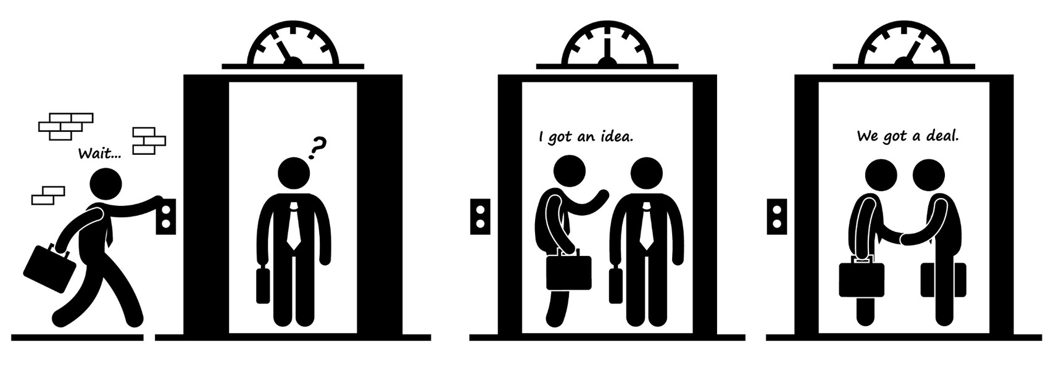

Elevator Pitch

Slide 3
Elevator Pitch
Change the way blogging is valued! Let your most passionate fans support your creative work via a credit system that, in exchange, allows you the freedom to do your best work and the stability you need to build an independent creative career.

Slide 4
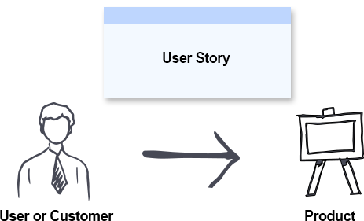
concept

Slide 5
concept
As a
blogging community,
I want
when readers visit specific articles on our sites,
So That
When users enter their details and press ok,
<We need a micro-billing service that allows us to charge a small fee per article to the readers of our blogs.>
<They will be presented with a splash page asking them to join the micro-blogging service.>
<The join-up page should be as minimal as possible and offer free credits to lower the drop-off rate upon sign-up.>
<They will be presented with a second splash page thanking them for their support and the cost in credits to read the article>
<Once the reader confirms they wish to proceed, the splash page will disappear, allowing the reader access to the blog.>

Slide 6
concept
So That
When users enter their details and press ok,
<Once the user is signed up, should they visit another article utilising the same service, they will be presented with a splash page thanking them for their support.>
<On pressing OK, they will be charged credits and allowed access to the article.>
<Should readers not have any credits left, they will be presented with a splash page prompting them to purchase credits, allowing them access to more blogs in the future.
<To support the above, bloggers can access a website to add and edit the URLs of their blogs they wish to charge a fee for. Moving forward, the website can be used for readers to explore the blogs in the network. To aid in this, as bloggers sign up, they can input the description of their blog and add tags describing it.>

Slide 7






process

Slide 8
process
Breakdown of tasks:
Project Manager: Nate
Controllers - Michael & Nate
Models - Juan & Nate
Views - Chris & Nate

Slide 9
demo
Show your stuff!

Slide 10
Future development
Show your stuff!

Slide 11
Links
GitHub repo: https://github.com/ChrisNewbold/15-Project-2-Group-5
Deployed:

Slide 12
index
Elevator pitch (Juan)
Concept (Nate)
Process (Michael)
Demo (Nate and Chris)
Directions for Future Development (Chris)

